Slide 1


Conjunction and Interjection and Preposition
Explore the fascinating world of conjunctions, interjections, and prepositions. Discover their definitions, types, and examples.
by Faseh Tariq

Slide 2
Conjunctions: The Glue of Language
Definition of Conjunction
Types of Conjunctions
Examples of Conjunctions
Conjunctions connect words, phrases, or clauses within a sentence, enabling smooth flow and coherence.
Explore coordinating, subordinating, and correlative conjunctions, each with its distinctive role in sentence structure.
From common conjunctions like "and" and "but" to less-known ones like "neither...nor" and "either...or", we'll explore a range of examples.

Slide 3
Interjections: Expressions of Emotion
1
Definition of Interjection
Interjections are short exclamatory words that express strong emotions or reactions, adding flavor and emphasis to a sentence.
Examples of Interjections
2
From joyous exclamations like "Wow!" and "Yipee!" to expressions of surprise such as "Oh!" and "Aha!", interjections make language vibrant.
3
More Than Words
Interjections can also include sounds like "Ouch!" and "Hurray!", as well as non-verbal expressions like "Hmm" and "Psst".

Slide 4



Prepositions: The Relationship Builders
Definition of Preposition
Examples of Prepositions
Let's Go On a Preposition Adventure
Prepositions establish relationships between other words or elements in a sentence, such as time, place, or direction.
From "between" and "behind" to "through" and "towards", discover the versatile ways prepositions depict connections in language.
Take a journey with prepositions as we explore the nuanced relationships they create, guiding us from place to place.

Slide 5
Utilize Language Dynamics
Conjunctions
Interjections
Prepositions
Coordinating
Expressions of Emotion
Time
Subordinating
Non-Verbal Sounds
Place
Correlative
Direction

Slide 6
Language That Speaks Volumes
Conjunctions
Interjections
Prepositions
Unify Sentences
Express Emotions
Establish Connections
Enable Coherence
Create Excitement
Depict Relationships

Slide 7
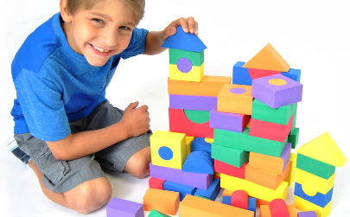


Exploring Language's Building Blocks
Conjunctions
Interjections
Prepositions
Conjunctions are like the building blocks that connect sentences together, forming a strong and cohesive structure.
Interjections are like fireworks, bursting with emotion and adding bursts of excitement to our language.
Prepositions are like scaffolding, providing a framework that supports the relationships between different elements of a sentence.

